Slide 1
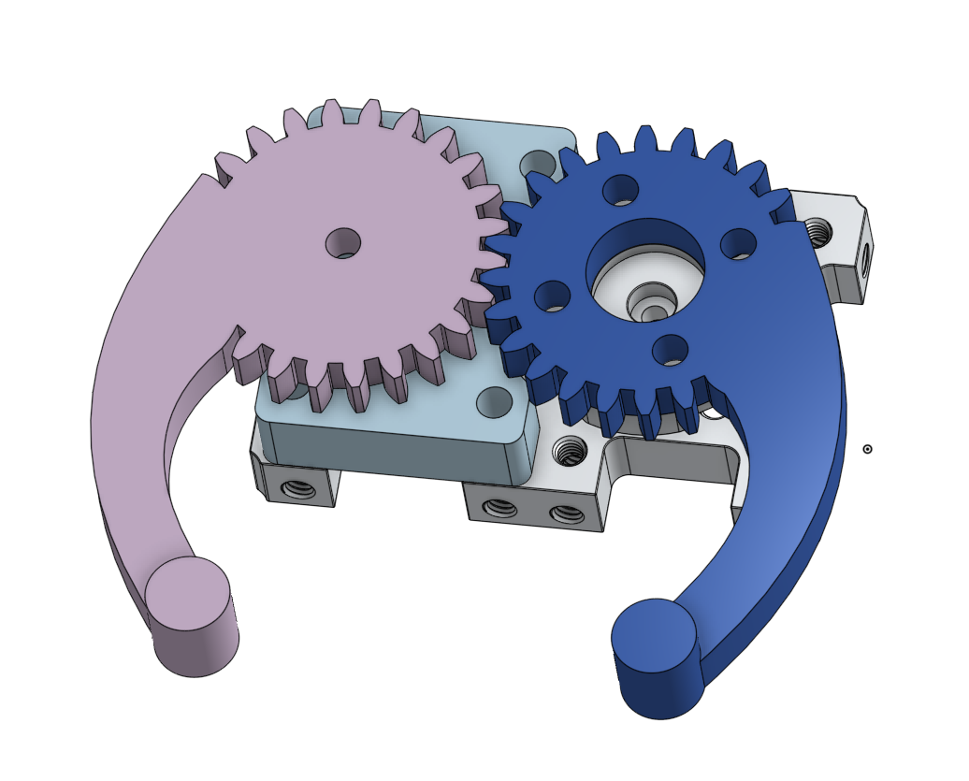
CAD a Claw
Mission to Mars – Sample Collection

Slide 2
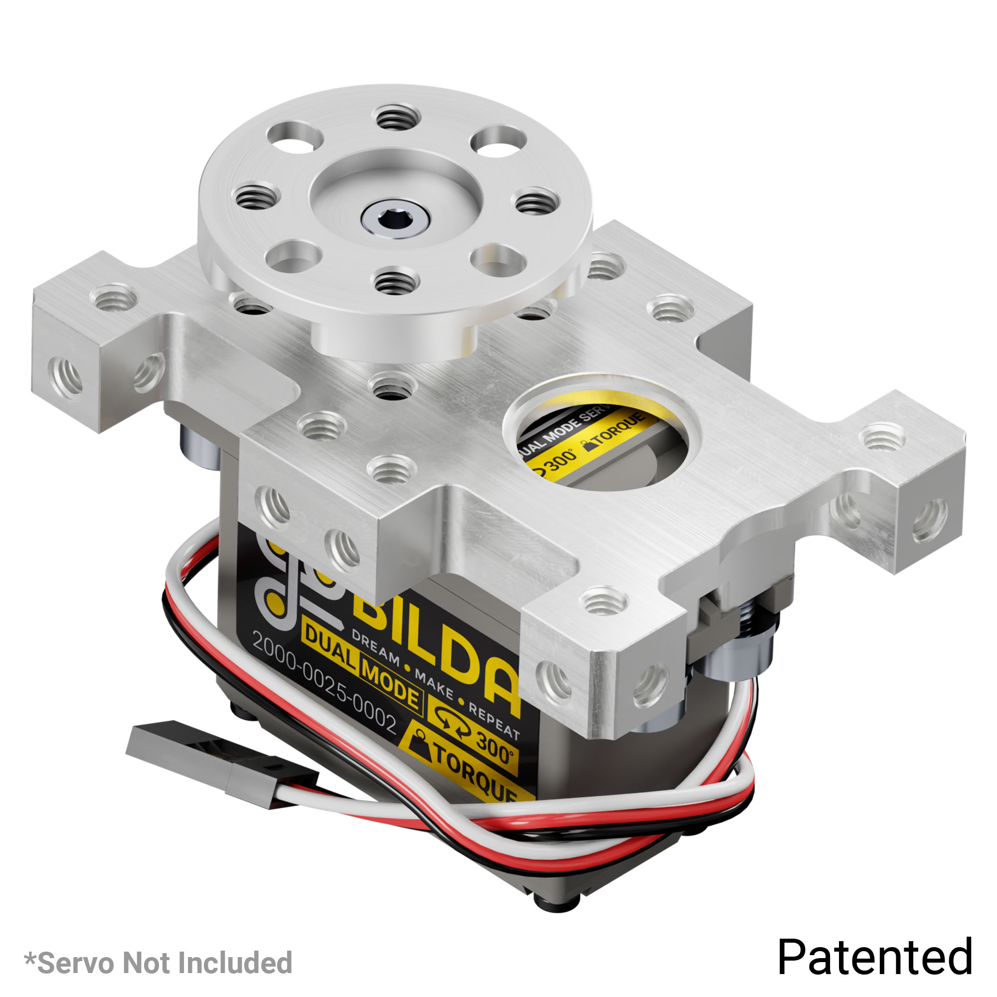
Claw Base – GoBilda ServoBlock
Provides a strong base
Support against radial forces
Many connectors to attach arms to
Build our claw around the servo block

Slide 3
Import ServoBlock
Get Step file from GoBilda page for the ServoBlock
Import to the Document using: + New Tab > Import
Point to the STEP file and wait for import to complete

Slide 4
Derive ServoBlock
Add to your Part Studio using the Derive command:

Slide 5
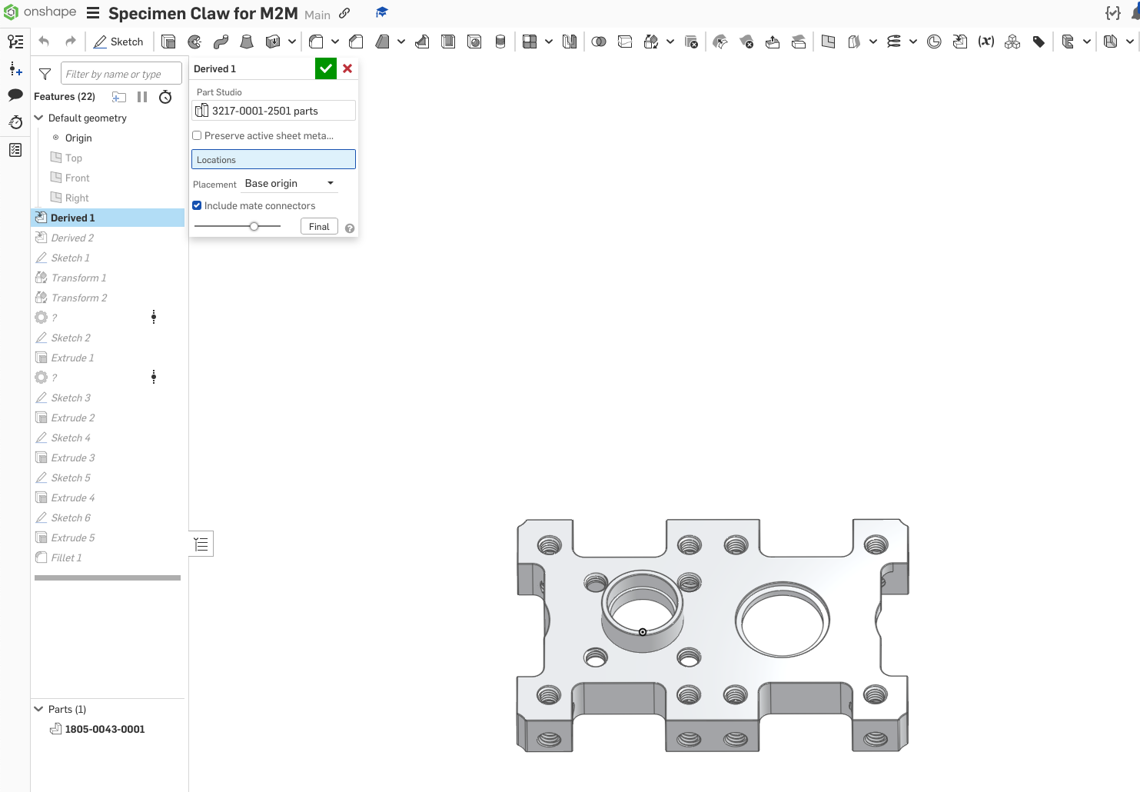
Derive ServoBlock
Add the ServoBlock and Servo Hub to the Part Studio

Slide 6
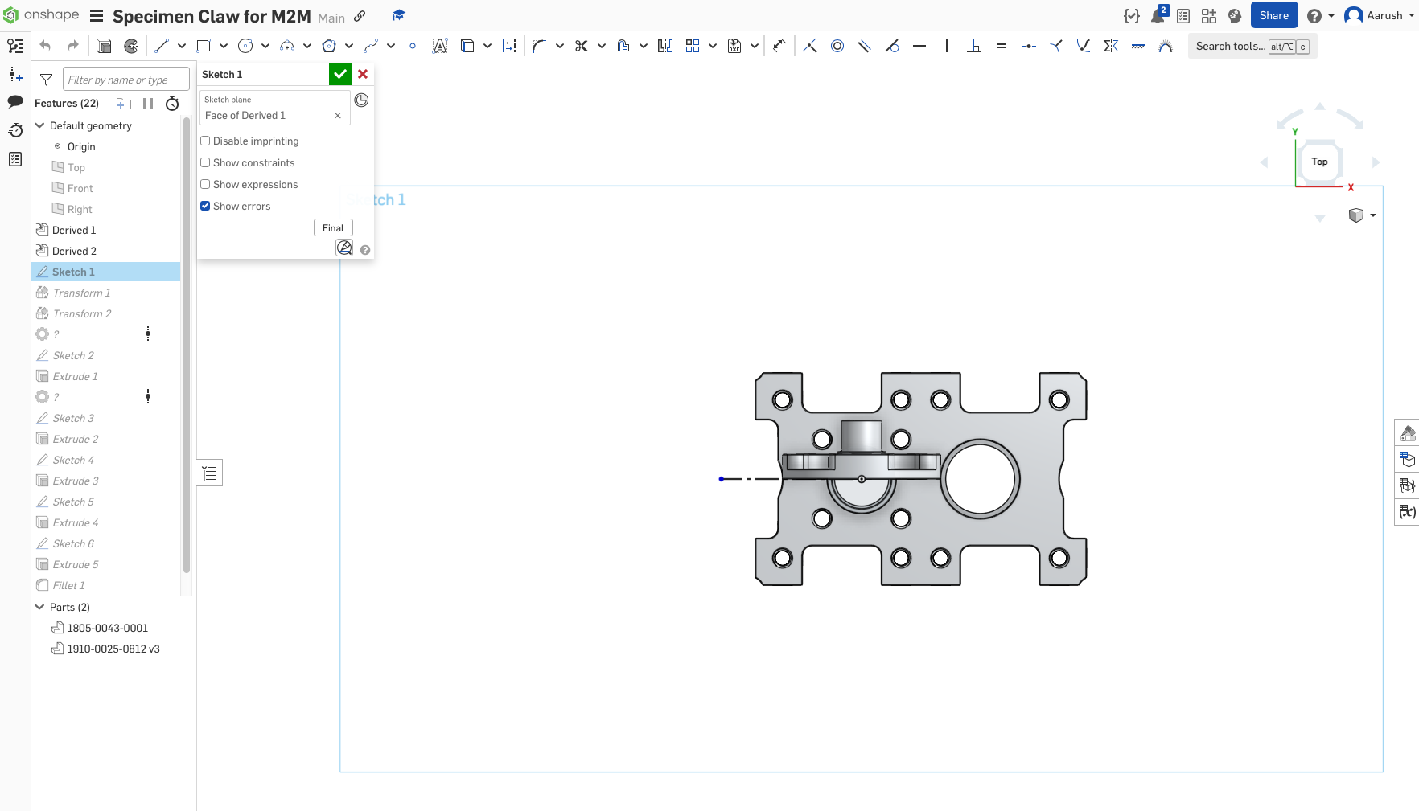
Sketch to Create Transform Axis

Slide 7
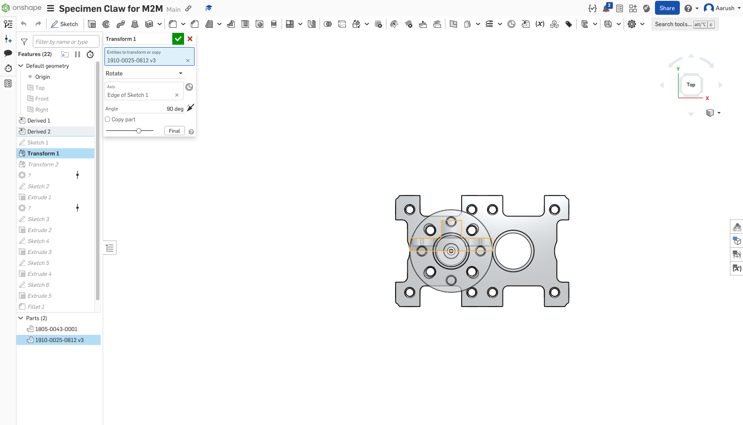
Transforms to align Servo Hub

Slide 8
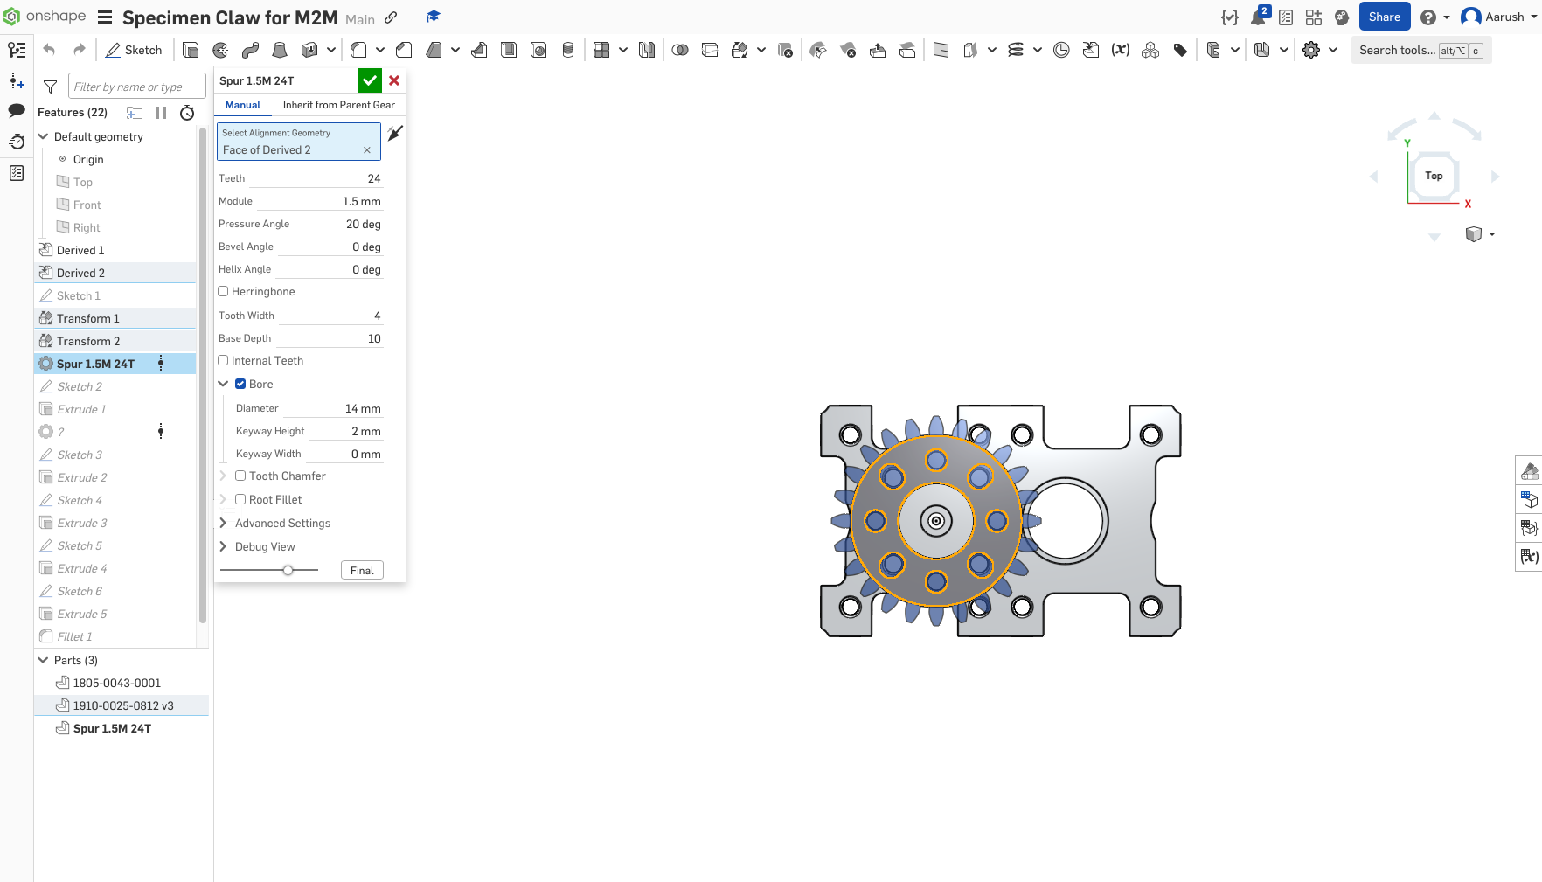
Add a Spur Gear using Gear Labs

Slide 9
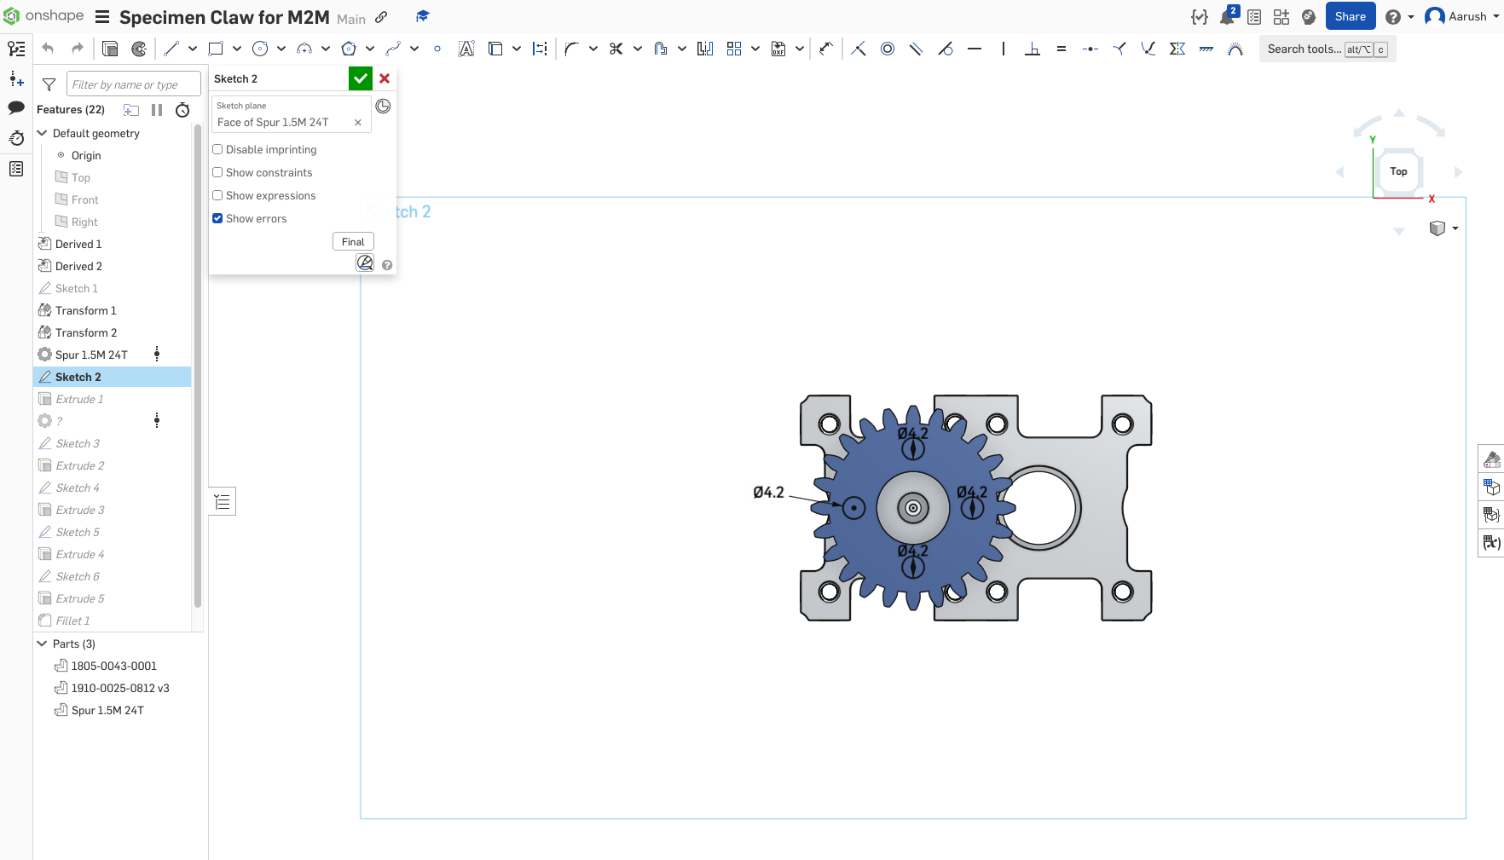
Scetch holes for Screws

Slide 10
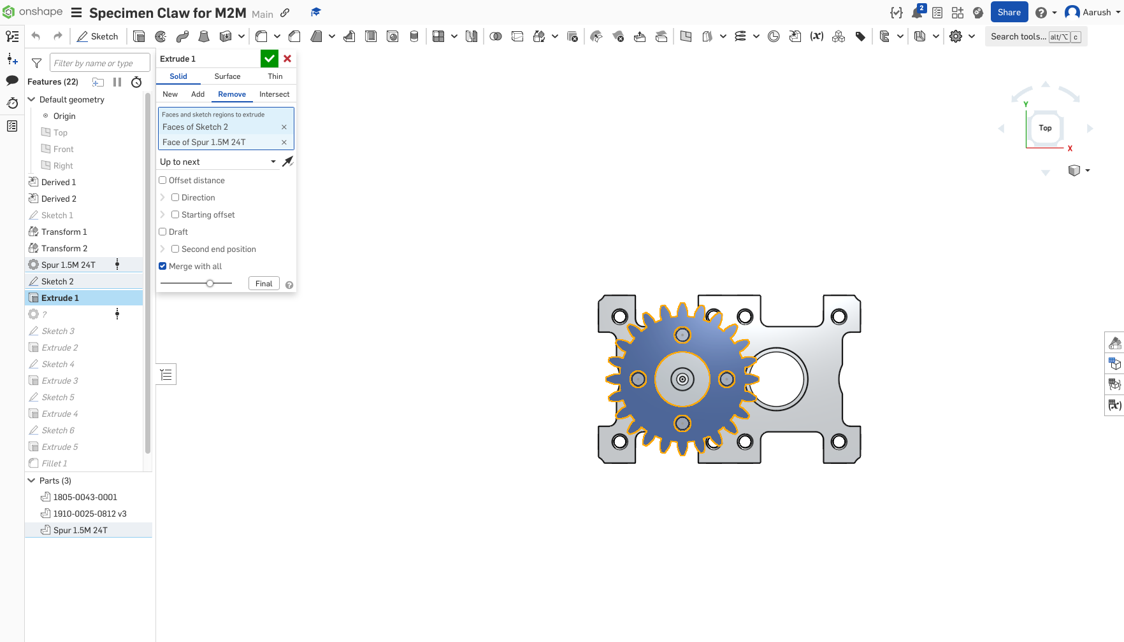
Extrude Screw Holes

Slide 11
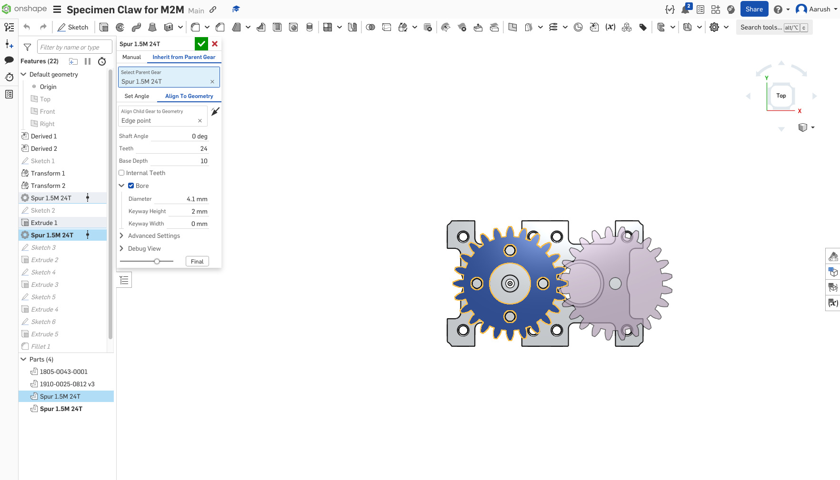
Add a second Spur Gear (inherit)

Slide 12
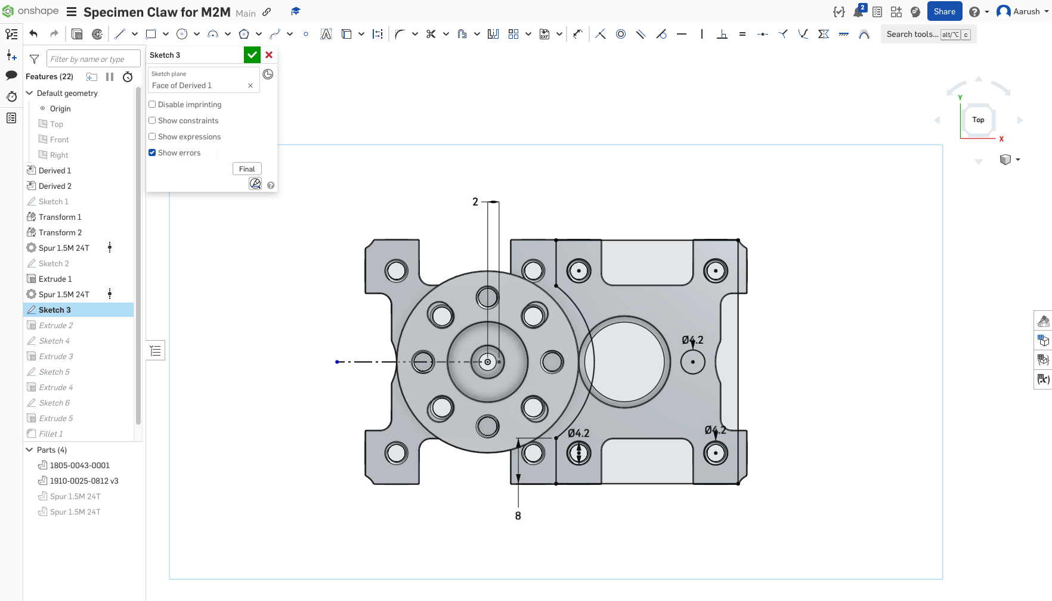
Build a Base for the Second Gear

Slide 13
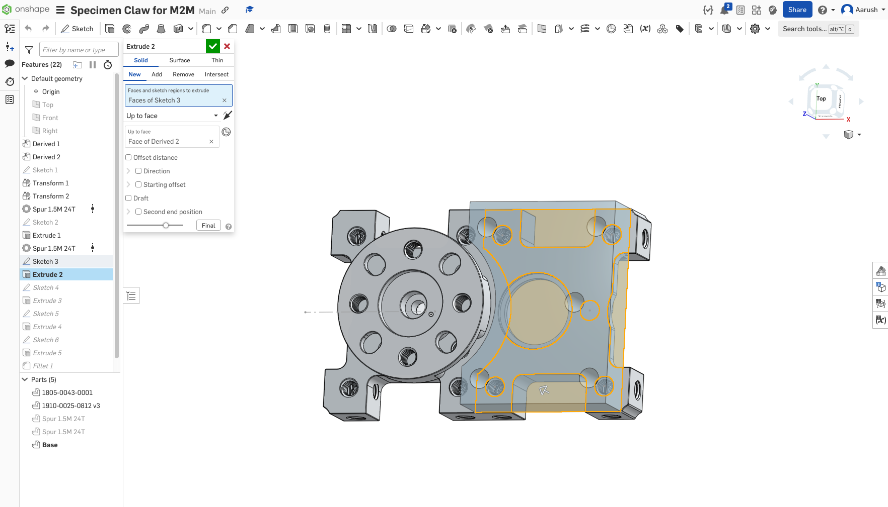
Extrude Base

Slide 14
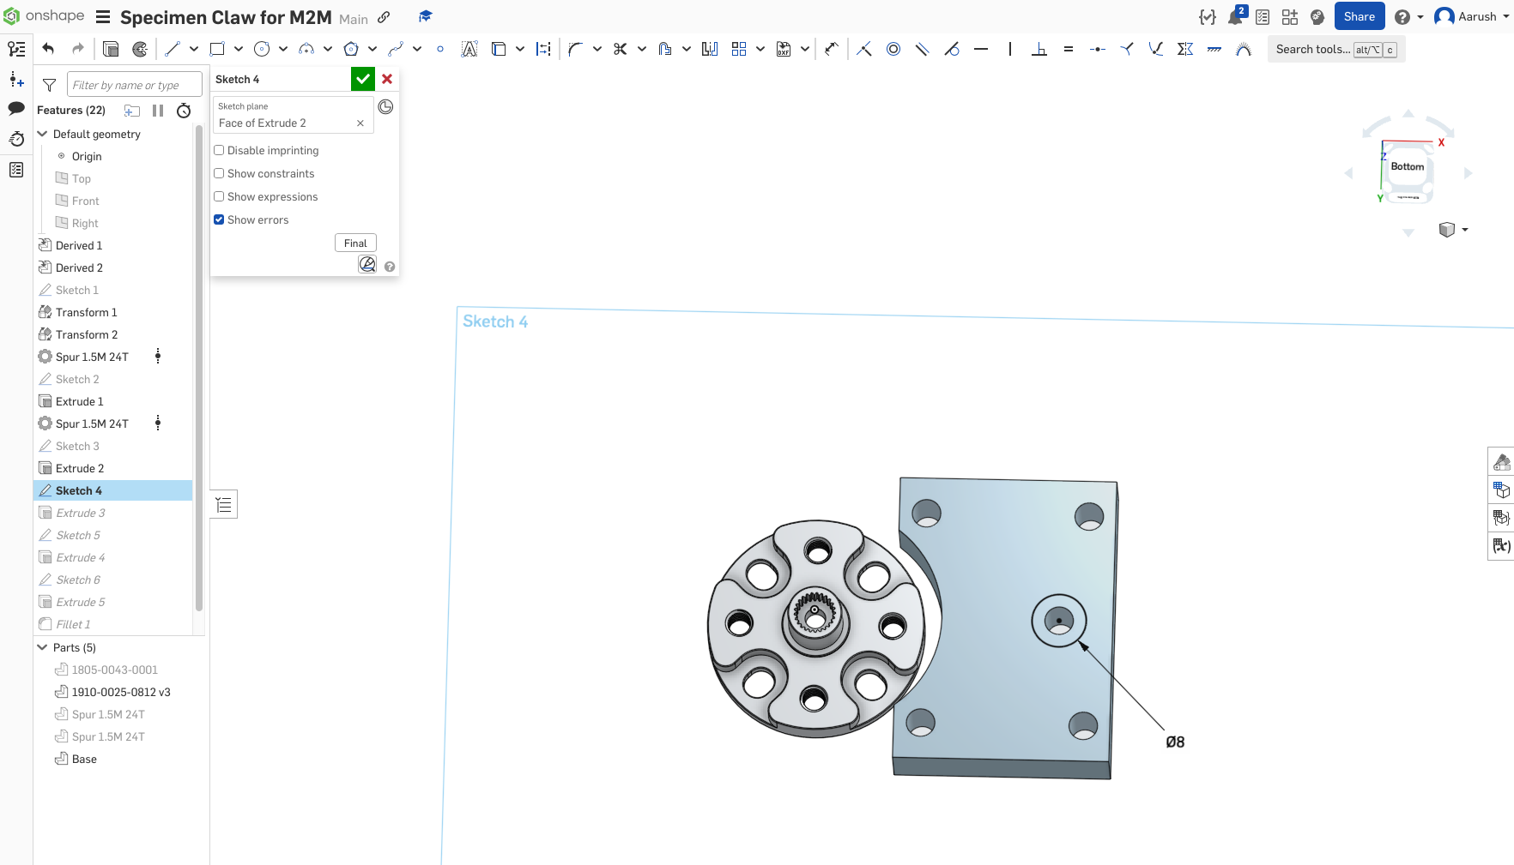
Sketch Hole at Base Bottom for Screw Head

Slide 15
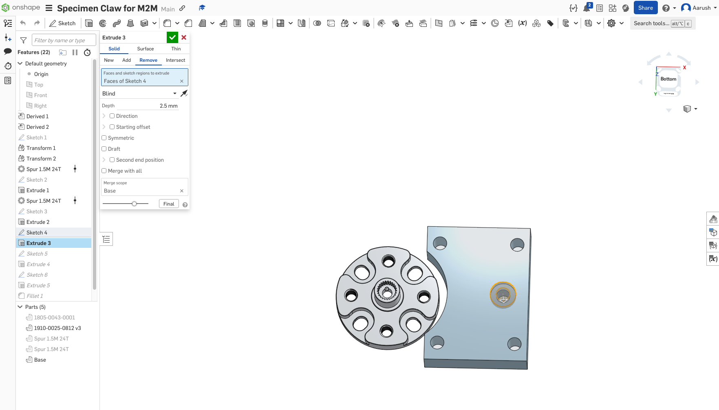
Extrude hole

Slide 16
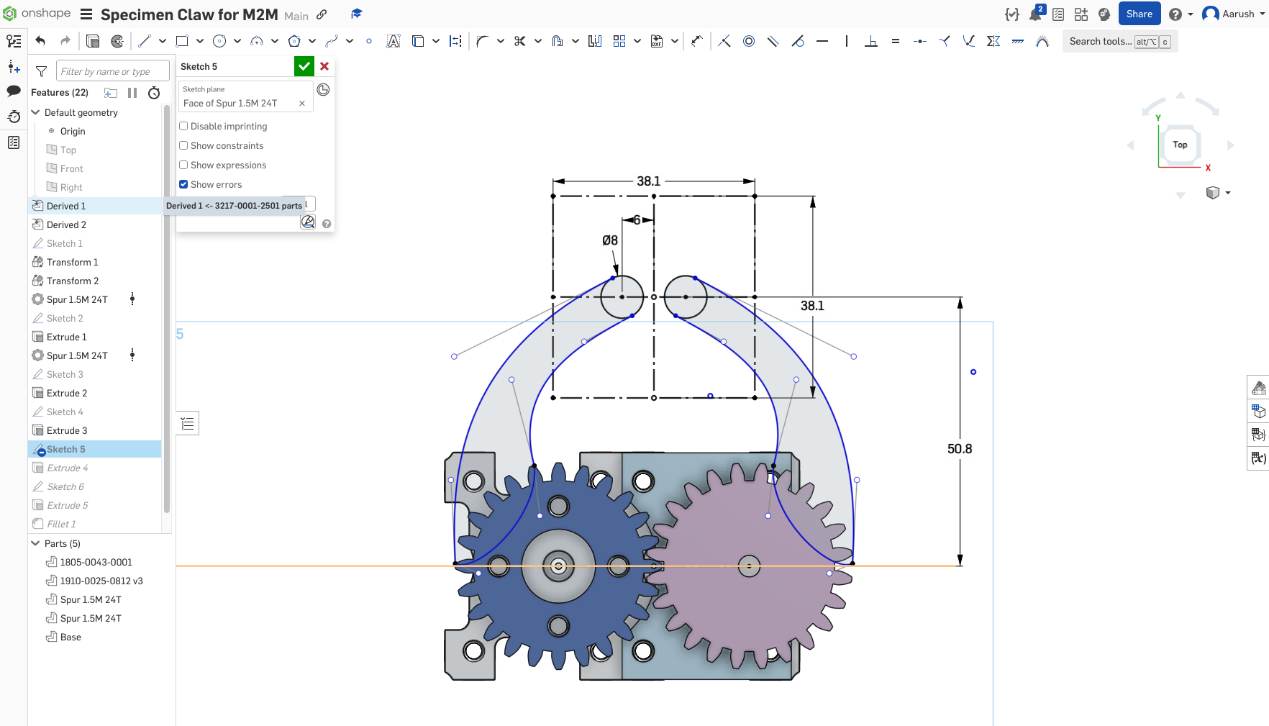
Sketch Claw Arms & Sample outline

Slide 17
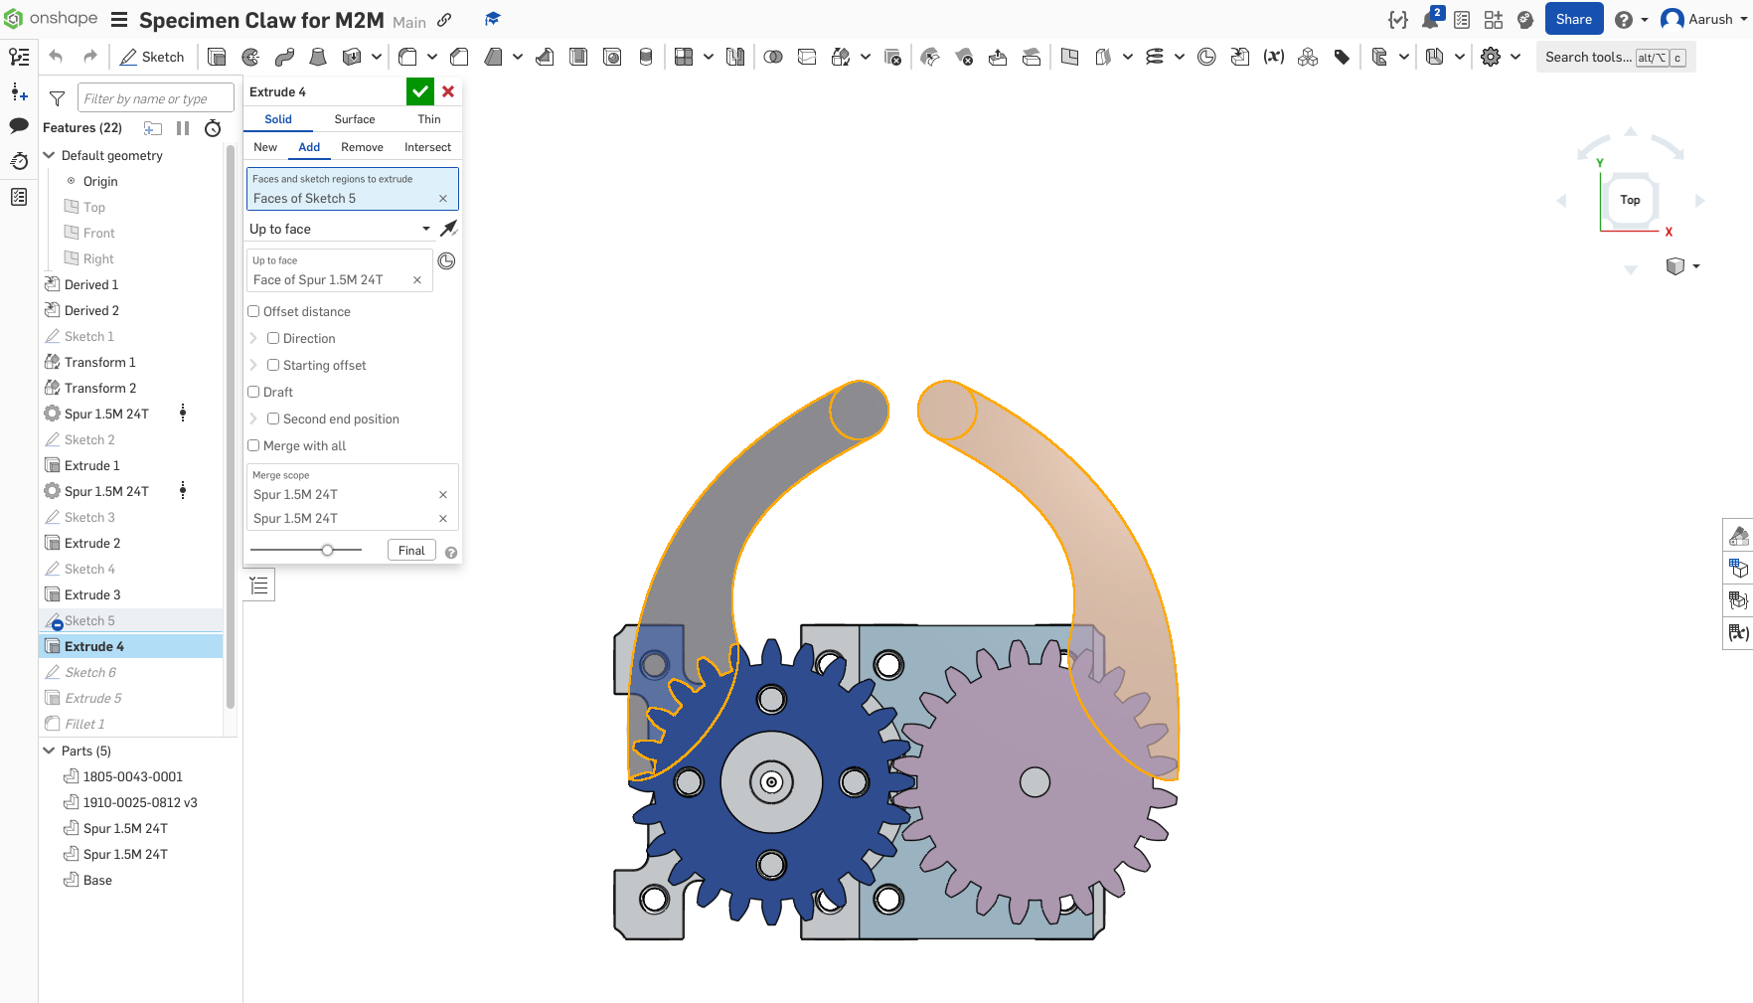
Extrude

Slide 18
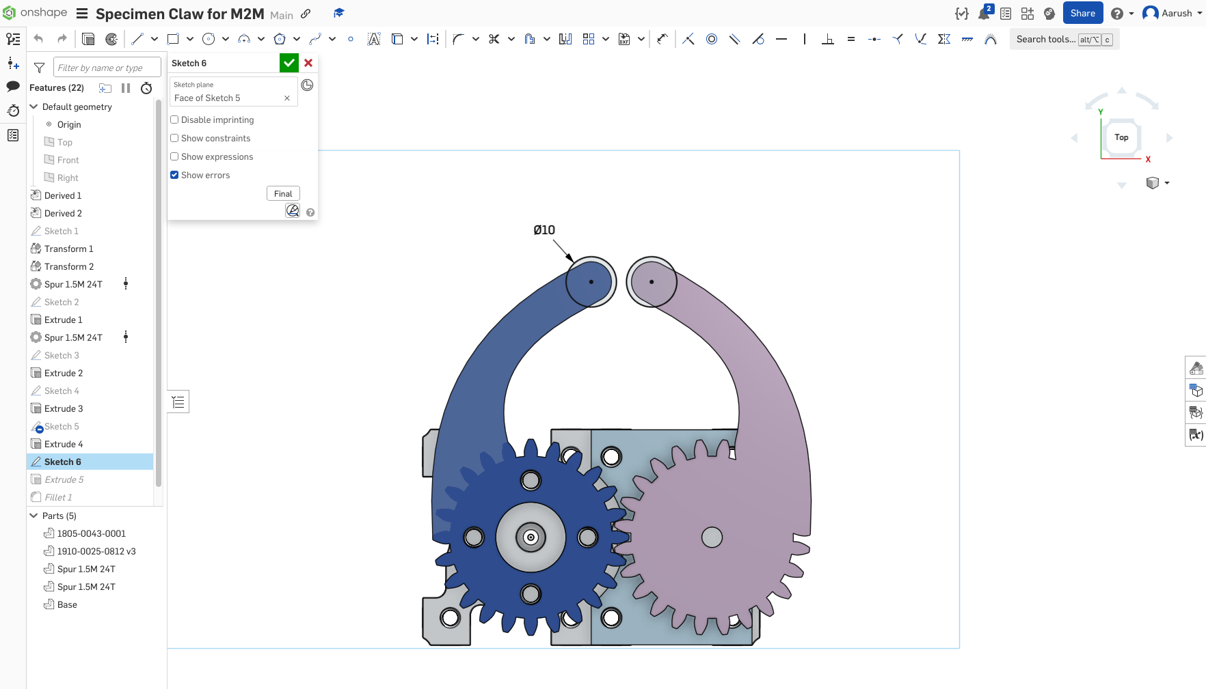
Sketch Claw Tips

Slide 19
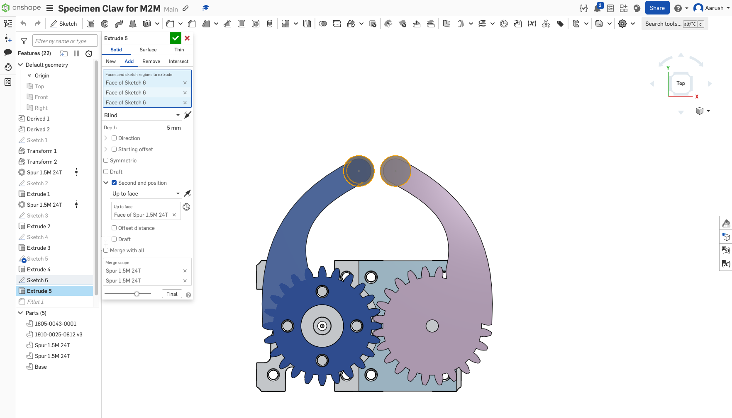
Extrude

Slide 20
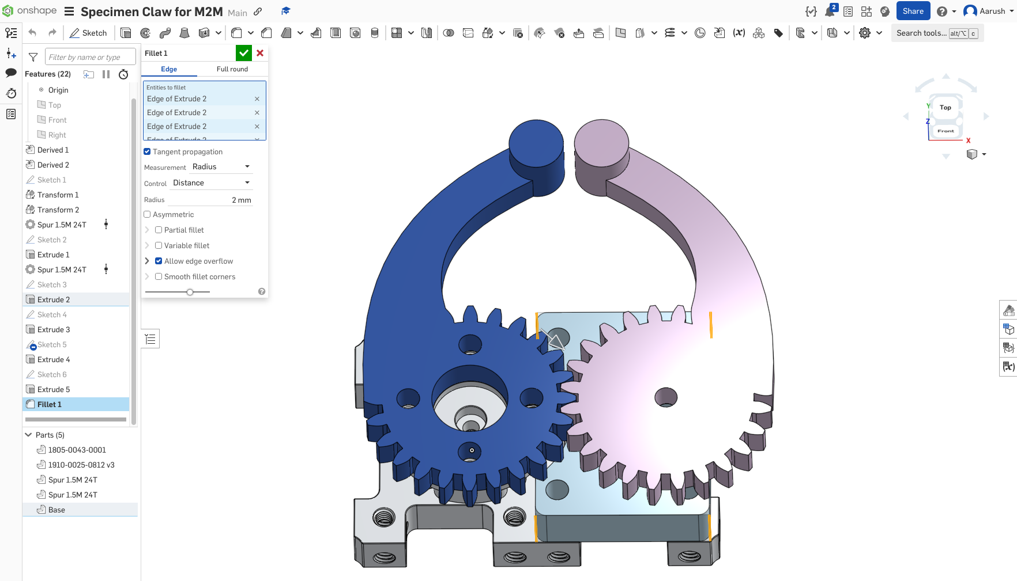
Fillet to smoothen base

Slide 21
Assembly

Slide 22
Add all parts to the assembly
Servo Block & Hub
Base
Left and Right Claw

Slide 23
Fix ServoBlock
Fasten Base and Hub to Block
Revolute mate:
Claw to Hub
Other Claw to Base (through screw hole)

Slide 24
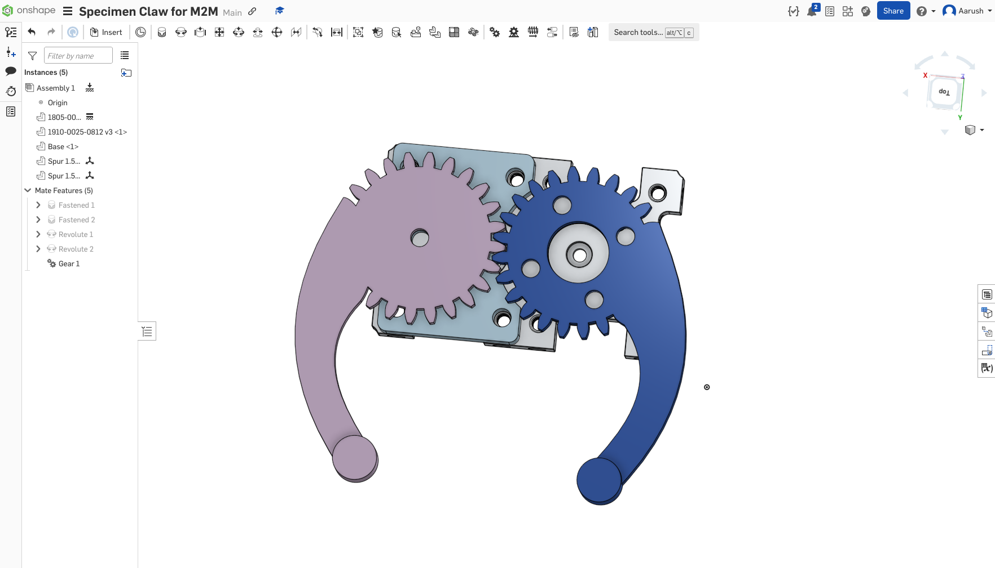
Assembly

Slide 25
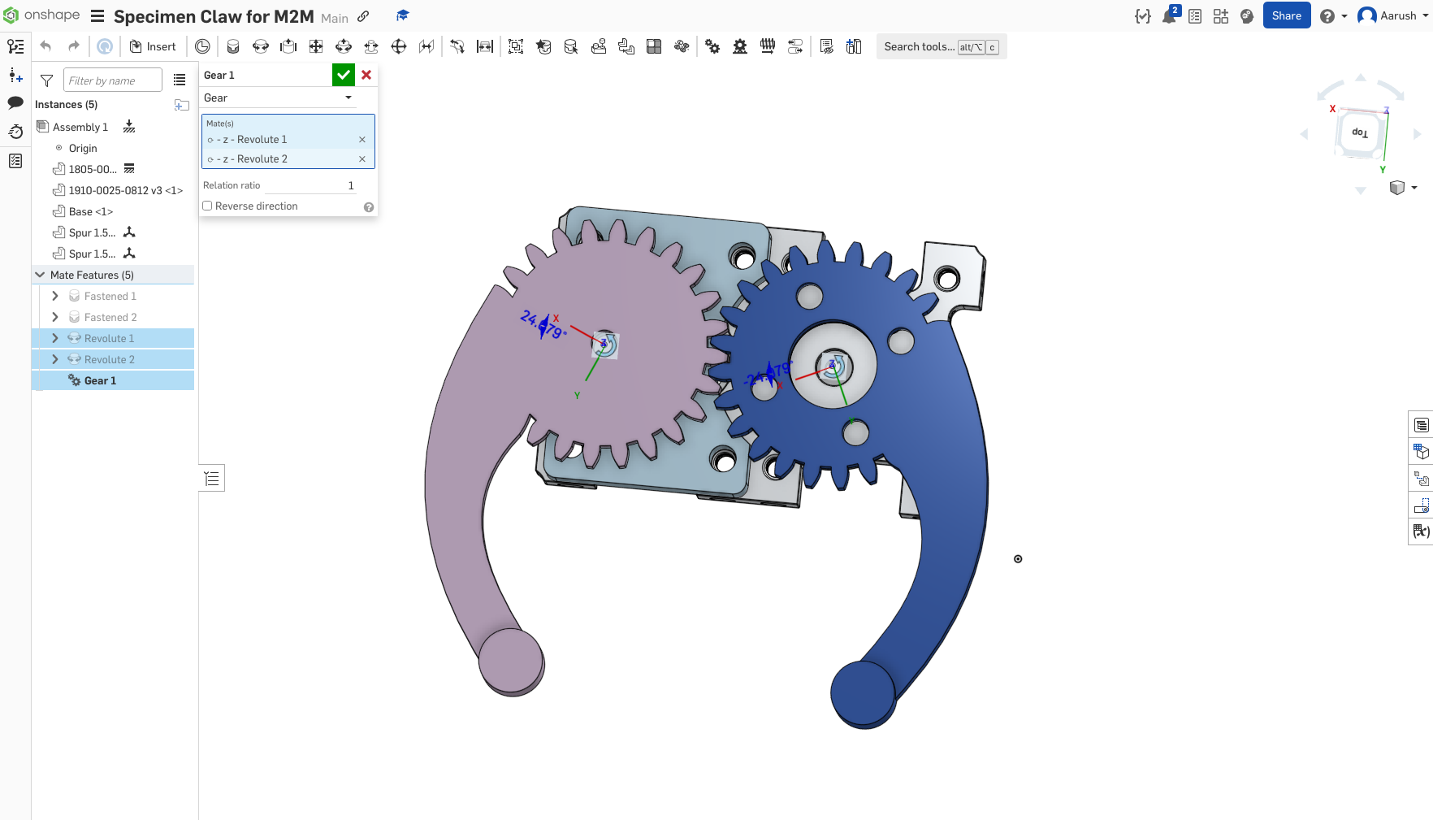
Set Gear ratios

Slide 26
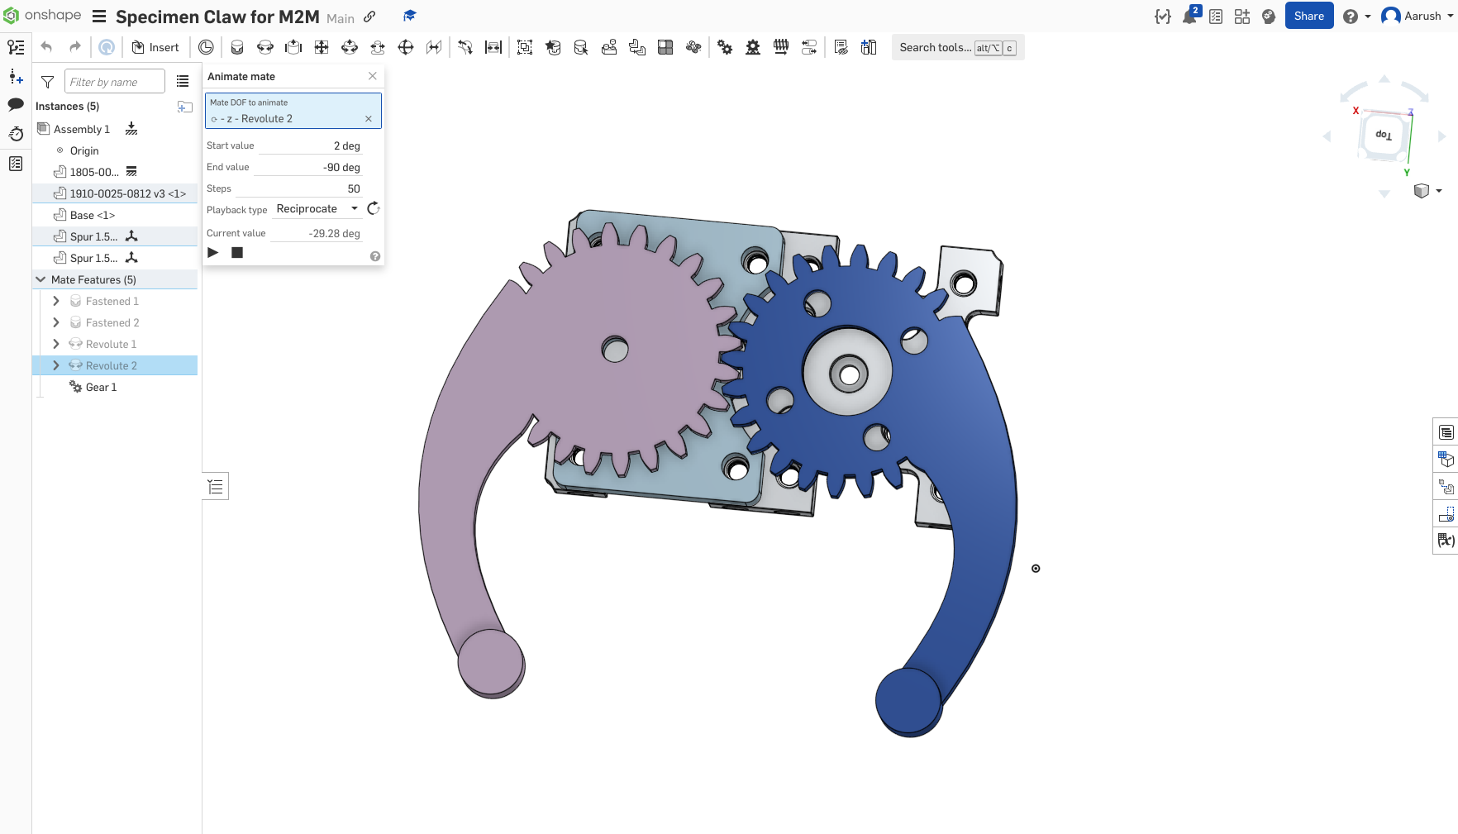
Animation Settings

